Slide 1
Gaston Early College
of
Medical Sciences
April 5, 2022
Parent Meeting

Slide 2
Vision
To develop lifelong learners who possess the courage to lead and the compassion to heal.
Mission
To provide students the opportunity to earn a high school diploma and an Associate's Degree in preparation for future careers in healthcare.

Slide 3
Agenda Items
Student Vital Checks
Transition Process
Students Supports
Program Overview
Advisory Classes
Activities
Tracking Progress
Electronic Portfolios
PreACT Scores
Community Partners
Questions

Slide 4
Vital Check: How are Our Students Doing?
Maintain a Cumulative GPA of 2.5 or higher* (3.0 Nursing)
94% Attendance Rate
Maintain Good Conduct
Grades of “C” or Higher
Fall Semester
High School Classes–98%
College Classes–96%
Spring Semester–3rd Quarter
High School Classes–98%
College Classes–90%
GPA | Fall 2021
2.5 or Higher GPA (overall %) | 97.1
61 Students on the A/AB Honor Roll
Fall 2021 % Days Attended | 94% or Higher | Less than 94%
Students | 57 (73.1%) | 21 (26.9%)

Slide 5
Making the Transition…
“Procrastination taught me how to do 30 minutes of work in 8 hours and 8 hours of work in 30 minutes.”
Quality Work
Postponing Assignments
“Free Time” is a Myth!
Advisory Time and/or Learning Lab Time
Homework vs. Classwork
Multiple Learning Platforms
Blackboard vs Canvas
MS Suite and Google
Fast Paced Classes
Semester Classes/Study Nightly
F2F/Blended and Online Classes
Finding Your Voice
Contacting Instructors/Teachers for Questions
Asking for Extra Help
Taking Responsibility
Attendance/Tardies
Monitoring Grades and Assignment Deadlines
Time to Study

Slide 6
Student Supports
Personalized Student Schedules
Class Loads
Learning Labs
Mandated Re-Tests
Less than 75
Tutoring/Testing During Advisory Period
Advisory Class
Grouped by Pathway
Teacher Tracks Grades/Assignments
Extra Help/Support and Study Time
College Liaison & School Counselor
Grade Alerts
Meeting w/ Students
Continuous Improvement….
Student Surveys for Feedback
Interviews with College Instructors
Developing Advisory Curriculum by Grade
Summer Class Options

Slide 7
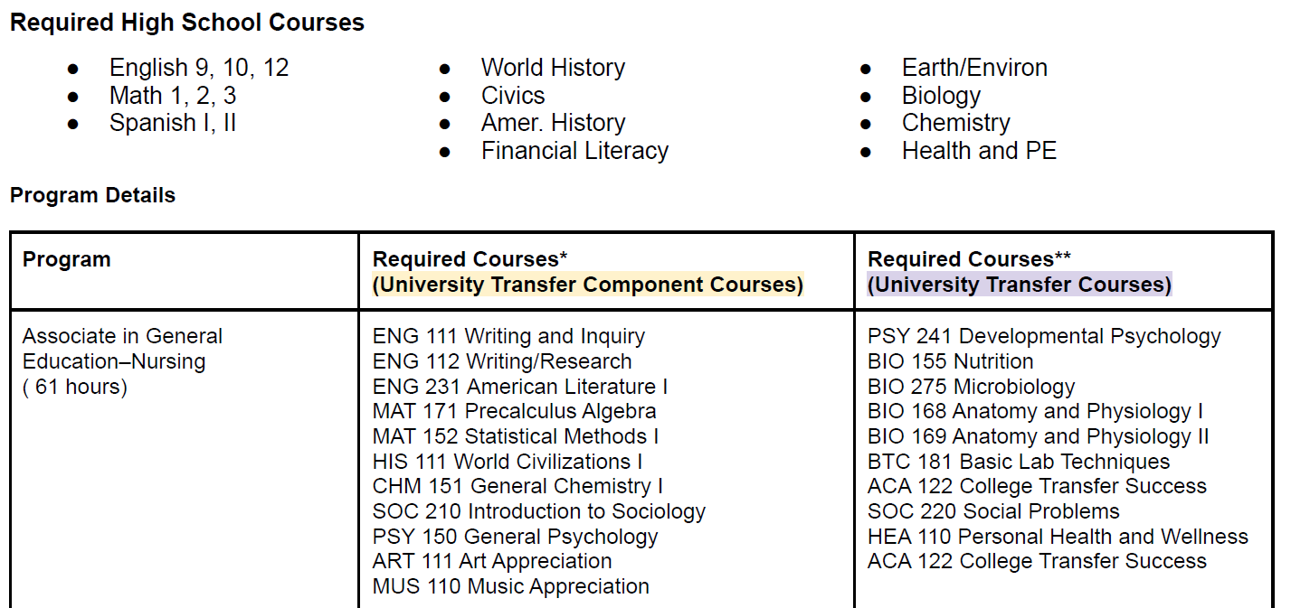
Associate in General Education–Nursing
A College Transfer Program

Slide 8
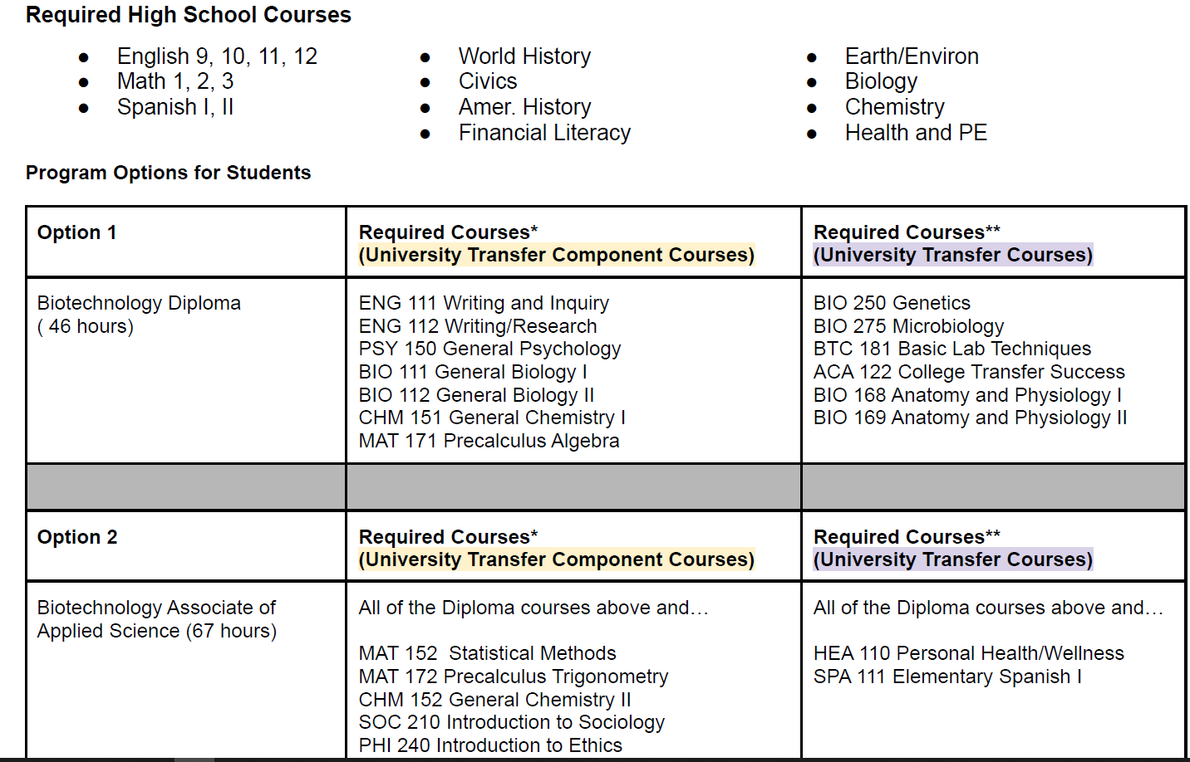
Associate in Biotechnology
A College Transfer Program

Slide 9
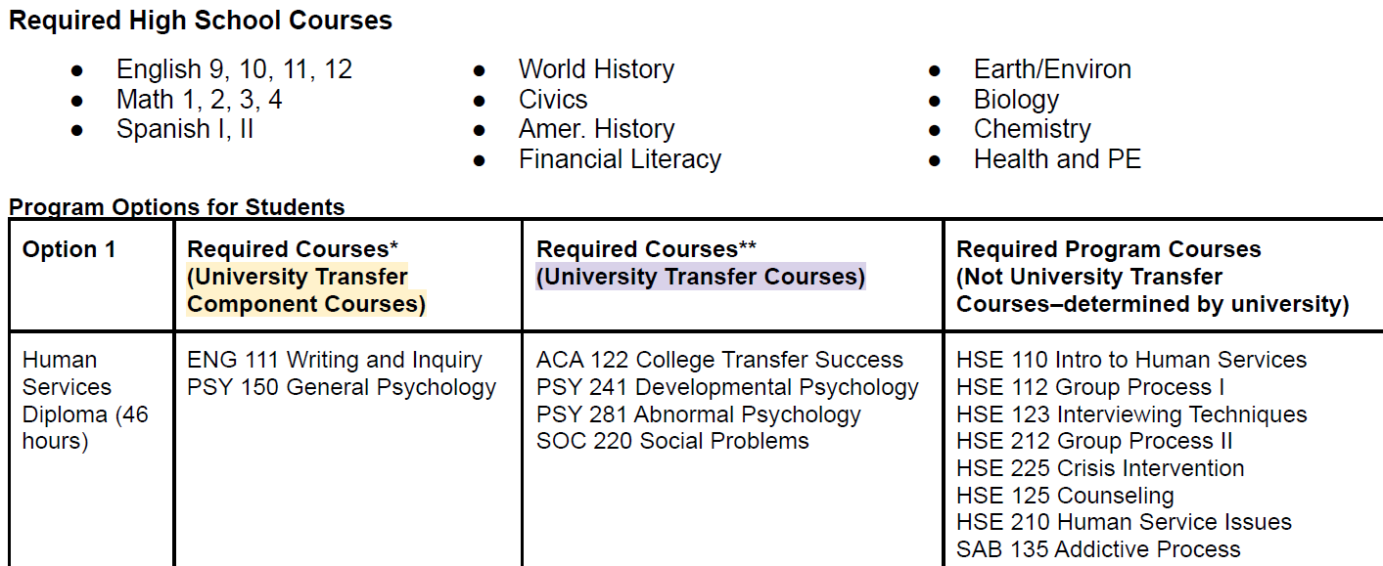
Associate in Human Services

Slide 10
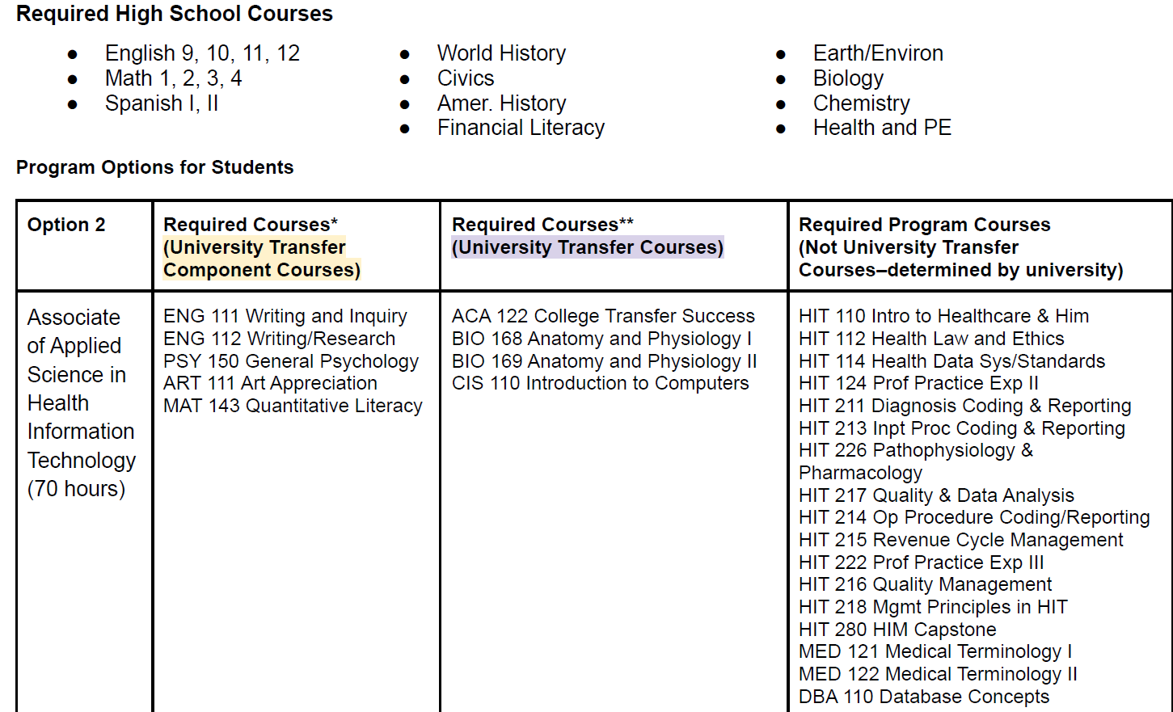
Associate in Health Information Technology

Slide 11
Advisory Class
Advisory Activities
Meet with students individually to discuss career aspirations and required coursework
Accompany students to college transfer events hosted by Gaston College (UNCC, Lenoir Rhyne, NC State, Gardner Webb)
PreACT whole class discussions
GPA and goal setting activities
Advisory Student Documents
Transcript
Program Checklist
Semester Goal Setting Document (green cardstock)
Student Progress Tracker- PreACT and PSAT
Quick look up with grades as of 4/5/22
Electronic Student Portfolios
Goal is for students to utilize google folder created by Mrs. Lackey to house high school resume, college application essays, scholarship essays, volunteer logs, and any other important documents they’ll need for college applications
Example portfolio

Slide 12
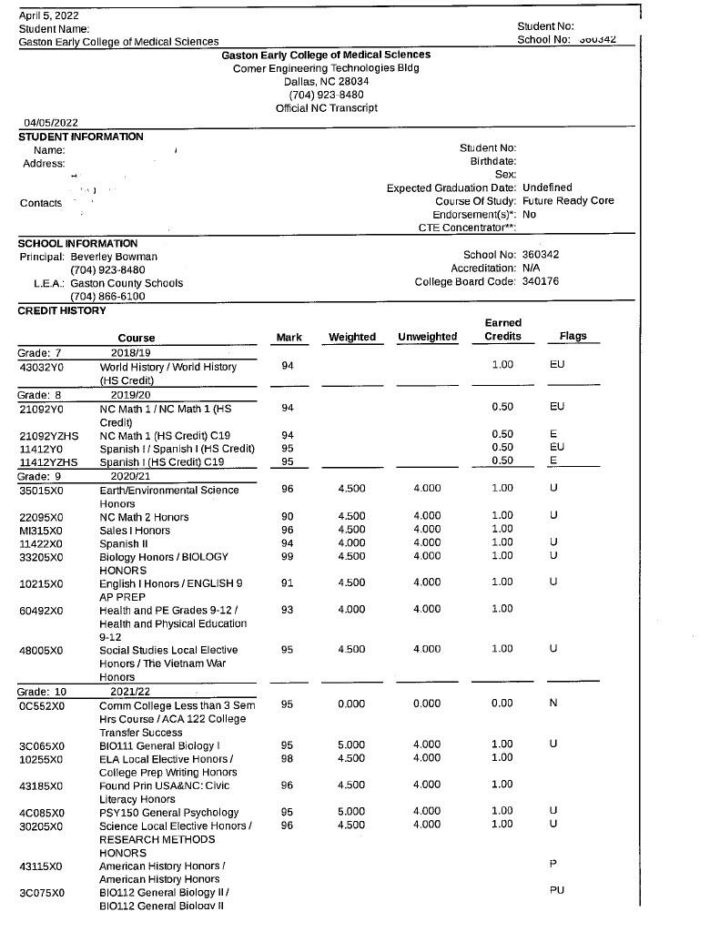
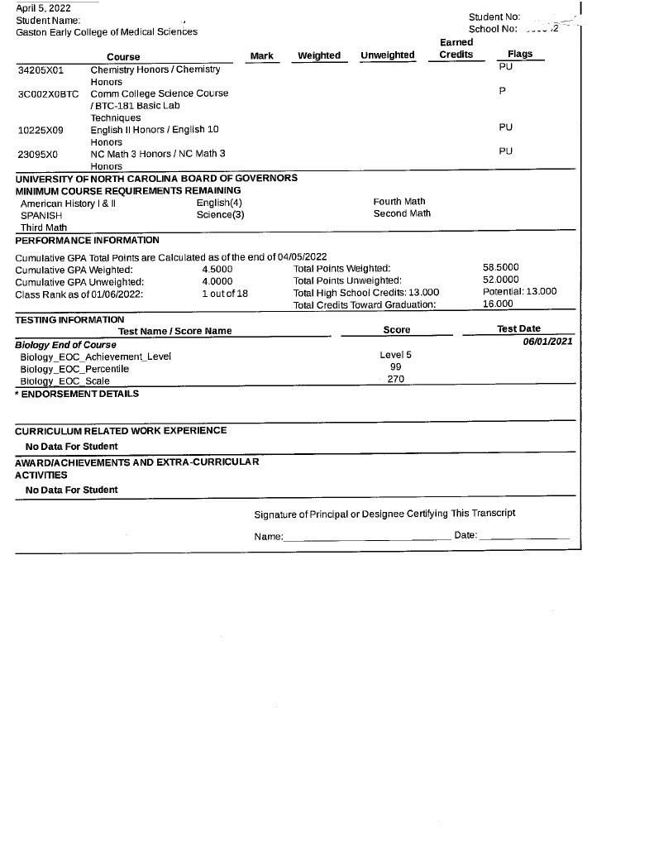

Slide 13
College Readiness
College Entrance Exams
9th Grade
Fall PreACT 8/9
10th Grade
Fall PSAT
Fall PreACT 10
11th Grade
Winter ACT
SAT (Recommended to Compare to ACT Score)
Note: We will begin meeting with our rising juniors next fall to begin developing post-secondary plans.
https://www.northcarolina.edu/future-students/transfer-students/nc-community-college-transfer/

Slide 14
The PreACT
What is the PreACT?
What should I do next?
How can I improve my score?
PreACT and the ACT® tests cover the same subject areas: Math, Science, English, Reading.
The PreACT and the ACT measure your college readiness skills as you progress through high school.
PreACT scores can be used to predict how you’ll score when you take the ACT as an 11th grader.
Meet with Mrs. Lackey for an in depth look at your scores and to develop a personalized plan.
Work with your teachers in subject areas you wish to improve (look at detailed results on your score report).
Keep in mind that the score range for ACT is only an estimate. You need to keep working at learning to ensure the highest score possible.
Review your score report for areas where you scored below the Readiness Benchmark.
Utilize free resources from www.act.org
Additional free ACT resources can be found here

Slide 15
Pre ACT 8/9, Pre ACT, and ACT Benchmarks
PreACT 8/9 score range 1-30
PreACT 10 score range 1-35
ACT score range 1-35
You are on track to be college ready if you scored at least the following in each tested area
 | Math | Science | STEM | English | Reading
Pre ACT 8/9 | 17 | 18 | 21 | 12 | 17
Pre ACT 10 | 19 | 20 | 23 | 14 | 19
ACT 11 | 22 | 23 | 26 | 18 | 22

Slide 19
What score do I need on the ACT?
Average SAT and SAT score ranges for NC public colleges
All juniors take the ACT for free in February each year.
Recommended to take SAT and ACT junior year, then take whichever exam you liked best a second time.
The higher your test score, the more likely you are to be admitted to competitive college majors, earn scholarships, and be considered for college honors programs.
 | SAT range | ACT range | GPA range
Appalachian State | 1100-1270 | 22-28 | 3.82-4.34 (weighted)
East Carolina | 1070-1190 | 19-24 | 3.10-3.41 (unweighted)
Elizabeth City St. | 890 | 18 | 3.19
Fayetteville State | 942 | 18 | 3.27
NC A&T State | 1080 | 21 | 3.7 (weighted)
North Carolina Central | 929 | 18 | 3.27
NC State University | 1310 | 29 | 4.17-4.48 (weighted)
UNC Asheville | 1176 | 25 | 3.5
UNC Chapel Hill | 1350-1500 | 29-34 | 4.39+ (weighted)
UNC Charlotte | 1130-1280 | 22-27 | 3.8-4.5 (weighted)
UNC Greensboro | 1110-1200 | 23 | 3.74 (weighted)
UNC Pembroke | 1023 | 19 | 3.44
UNC Wilmington | 1277 | 24-28 | 4.06 (weighted)
Western Carolina | 1150 | 23 | 3.78 (weighted)
Winston-Salem State | 963 | 18 | 3.31 (weighted)

Slide 20
How can I prepare for the ACT?
ACT Test Prep & Free Resources
Gaston College PrepStep
FREE resource for students
SAT and ACT prep
Click here to set up your account
**Families who could qualify for free or reduced lunch should complete the application each year. FRL approved families qualify for college fee waivers, SAT/ACT fee waivers, and free Kaplan accounts.
Free Study Guide
Question of the day
Free Practice for each test section
General Test Tips
Test Descriptions
www.act.org
ACT Kaplan Online Resources
All ACT Kaplan resources are free to any student registering for the ACT with a fee waiver.
Free recorded videos for all students for each content area.
https://kaplan.com/

Slide 21
Pre-ACT Grade Level Results
Difference Benchmark | PreACT 8/9 9th Graders
 | Composite | Math | Science | English | Reading
10th GECMS | 19.8 | 18.3 | 20.9 | 15.4 | 24.3
10th National Mean | 18.1 | 18.2 | 17.9 | 16.2 | 19.7
Difference | 1.7 | .1 | 3.0 | -0.8 | 4.6
9th GECMS Mean | 20.2 | 20.1 | 19.8 | 17.2 | 23.5
9th National Mean | 17.3 | 17.6 | 16.9 | 15.6 | 18.4
Difference | 2.9 | 2.5 | 2.9 | 1.6 | 5.1
30 is Highest Score
ACT Benchmark Goal* | 24 | 22 | 23 | 18 | 22
In general, a good ACT score is any score in or above the 75th percentile — at least a 24.
Students should aim to hit or exceed the middle 50% of ACT scores at their chosen colleges.

Slide 22
Health Career/Pathway Advisory
Gaston College:
Dr. Allison Abernathy Dean, Health & Human Services
Dr. Jennifer Nichols, VP Educational Partnerships
Dr. Heather Woodson, VP Academic Affairs
Leslie Pressley, Director of Nursing Programs
CaroMont Health:
Dr. Janice Hill, Director Nursing Workforce Transition Program
Elisabeth Hardin, Director Organizational Development
Ashley Long, VP, Chief Nursing Officer
Gaston County Schools:
Dr. Jill Payne, Director of Student Services
Beverly Bowman, Principal, Gaston Early College of Medical Sciences
Luci Huffstetler, CaroMont Health Academy/East Gaston High School
Jennifer Reep, Principal, CaroMont Health Science Academy/East Gaston HS

